Slide 1

Students Performance in Exams
Bobby Jung Basnet
May.09.2020

Slide 2
Abstract:
The purpose of this study is to analyze the student’s performance in exams that are impacted by the different variables such as gender, social category, quality of food, family education background, and their self-participation in various curriculum.
Objective:
The objective of this study is to find out the parent's educational background that affects student performance and shows the comparative result. Similarly, this analysis determines which racial/ethnic groups are performing better and figuring out the reasoning behind their performance. Moreover, how the meal and test preparation affect student performance. Finally, present which gender is better on what subject.
Audience:
The student can take benefit by seeing the effect of a test preparation course on their test score. Indeed, the students may discover the level their education could impact on their children’s education in the future. Parents can take benefits from this analysis because the quality of food could effect their children's performance. Simultaneously, it is beneficial for the government branch who is working to improve the education system among the minorities and under privilege racial/ethnic groups.

Slide 3
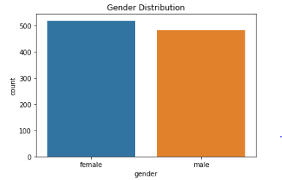
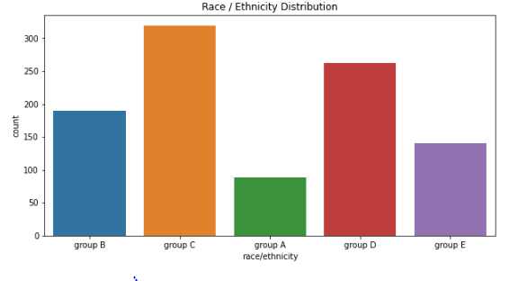
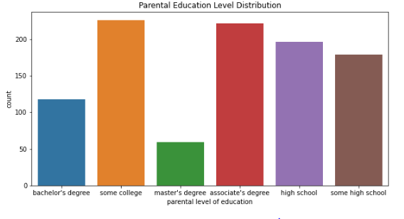
Data Description:
The data collection method was broadly grouped into two main categories: cause as a compare group and effect as a performance result. First, the cause was listed as the background of the students which includes the belonging to their racial/ethnic group, gender separation, and level of parental education background.

Slide 4
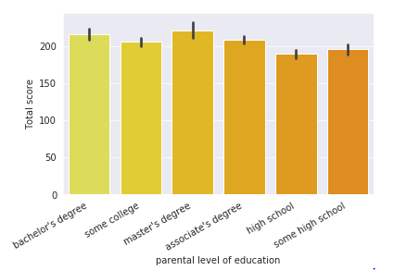
How Parents Education Level Effects student Performance?
The data shows that a parent's education level does affect their children. The bar plot clearly shows that the students are performing better if their parents have a higher level of education.

Slide 5
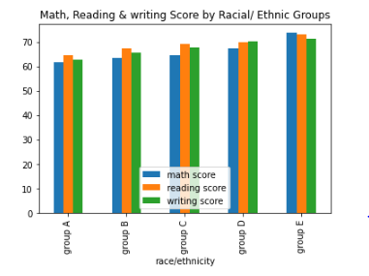
Which Racial/Ethnic group are performing better?
The racial group A student are weak on all three subjects, whereas the racial/ethnic group E is performing better.
Why racial E is better than any other group, is it because their parental education background is higher? Does racial group E have a higher level of parental education?

Slide 6
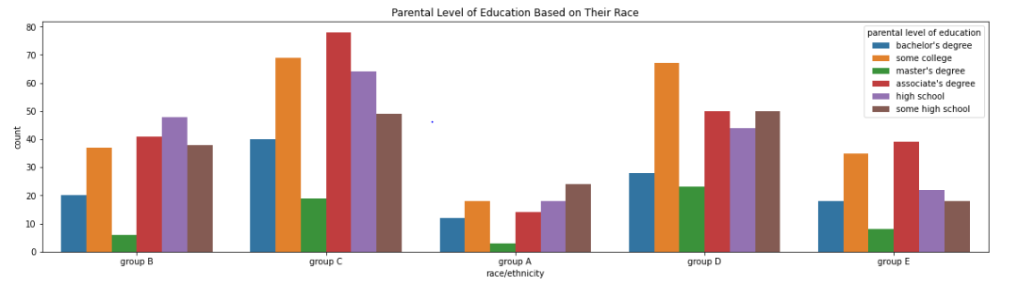
Why Group E is Performing Better?
Does Groups E’s parental level education is higher than any other groups?
In the racial C & D's parents has a higher level of education compared to racial group E. Thus, the performance of group E is not based on the parental level of education.

Slide 7
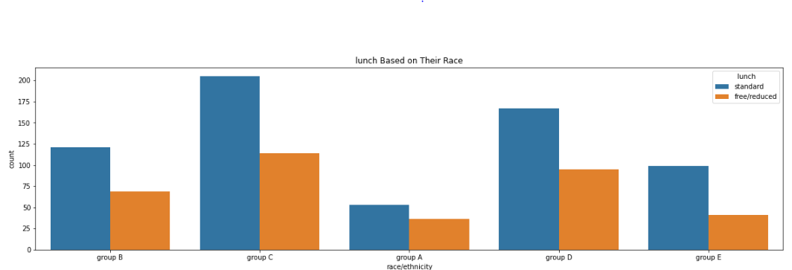
Lunch Vs Racial Group
The proportion of the student who is talking standard meals compare to free/reduce meal is higher for the racial group E group relative to group A. Therefore, the lunch is making some impact on student's performance.

Slide 8
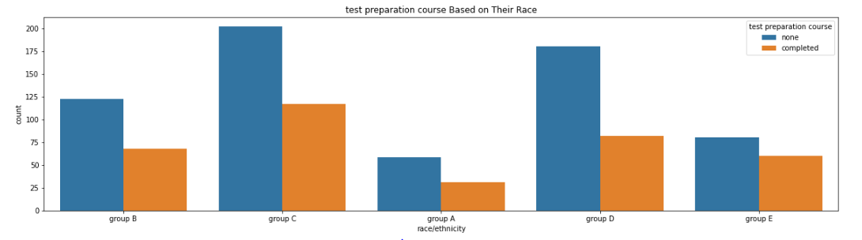
The Students From Racial Group E Is Participating more On Test Preparation Course?
The proportion of the students who completed the test preparation course is higher for group E compare to racial group A. Therefore, the test preparation course is making an impact on student's performance.

Slide 9
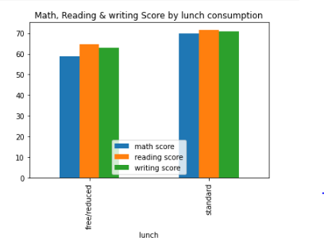
How lunch effect on students' test performance?
The students who were having standard lunch are performing better. Thus the meal does effect the student's performance.

Slide 10
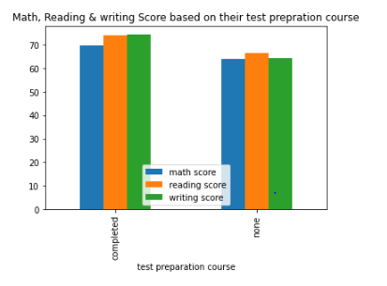
Does students are performing better when they complete test preparation course?
The students are performing better if they complete the test preparation course

Slide 11
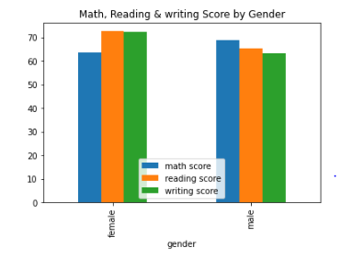
Female Vs Male
Male are performing better in math whereas female are doing better in reading and writing.

Slide 12
Conclusion:
The data was collected among 1000 students in 5 different racial groups. The data shows that students in the racial group are performing better because they participate more on test preparation course simultaneously most of the student takes a standard meal. Additionally, the parental educational background has a direct impact on student performance. Data shows that the students are performing better if their parents have a master's degree, while the students are performing weak if their parents did not have a high school degree. The data show males are performing better in math whereas females are doing better in reading and writing. The students who were having standard lunch are performing better. Thus the meal does affect the student's performance. Finally, The students are performing better if they complete the test preparation course

